Slide 1
Smart Classroom & Timetable Scheduler
CSE7302- Capstone Project
Review-5
Batch Number: CSE_7
Under the Supervision of,
Mr. Jerrin Joe Francis
Assistant Professor
School of Computer Science and Engineering
Presidency University
Roll Number | Student Name
20221CSE0714 | SHAMANTH M
20221CSE0713 | SANJEEV G
20221CSE0785 | SHASHIKIRAN S
Name of the Program: Computer Science and Engineering
Name of the HoD: Dr. Blessed Prince , Dr. Asif Mohamed
Name of the Program Project Coordinator: Dr. Jayavadivel Ravi
Name of the School Project Coordinators: Dr. Sampath A K , Dr. Geetha A

Slide 2
Problem Statement Number:
Organization: Government of Jharkhand
Category : Software
Problem Description: Traditional academic scheduling and classroom management systems are inefficient, manual, and time-consuming. Institutions face frequent issues such as timetable clashes, uneven resource allocation, overlapping faculty schedules, and lack of real-time classroom utilization insights.
The need is to build an automated Smart Classroom & Timetable Scheduler that:
Allocates classrooms intelligently
Generates error-free timetables
Utilizes AI-based optimization
Provides transparency and efficient management

Slide 3
Content
Abstract
Literature Survey
Objectives
Existing Methods and Drawbacks
Proposed Methods and Feasibility Study
Architecture Diagram
Hardware and Software Details
Timeline of the Project (Gantt Chart)
References

Slide 4
Abstract
Manual timetable preparation is time-consuming and often causes conflicts related to faculty availability, classroom capacity, and subject scheduling.
The Smart Classroom & Timetable Scheduler automates timetable generation and classroom allocation through a centralized web application.
The system uses a layered architecture with a user interface, scheduling engine, and relational database for efficient management.
It eliminates scheduling conflicts, optimizes classroom usage, and improves administrative efficiency in educational institutions.

Slide 5
OBJECTIVES
To develop a production-ready web-based timetable scheduling system that automatically generates conflict-free classroom and faculty schedules.
To reduce timetable generation time and improve interactivity using a hybrid scheduling approach that provides quick previews and optimized final schedules.
To enable flexible, rule-driven scheduling by allowing academic constraints to be configured dynamically through a centralized database.
To ensure scalability, usability, and reliability through role-based access, centralized data management, and validation against standard and real institutional scenarios.

Slide 6
Literature Analysis
Sl.no | Paper / Approach | Key Advantages | Limitations / Shortcomings | Future Scope
[1] | A Survey of University Course Timetabling Problem: Perspectives, Trends and Opportunities(2021) | • Comprehensive coverage of algorithms • Identifies trends and open challenges • Strong theoretical foundation | • No implementation details • No deployment perspective • No runtime comparison for real systems | • Bridge survey insights with production systems • Integrate algorithms into real web platforms
[2] | Babaei et al., C&OR (2015) – Survey | • Clear classification of timetabling approaches • Explains hard vs soft constraints well | • Outdated (pre-ML/RL era) • No modern web or scalability discussion | • Extend survey with hybrid, ML-based methods • Focus on real-time scheduling
[3] | ITC 2019 Benchmarks | • Standard datasets for fair comparison • Widely accepted evaluation metrics | • Misses institution-specific rules • Not designed for deployment use cases | • Extend benchmarks with real college constraints • Hybrid evaluation (benchmark + local data)
[4] | UniTime / Constraint Programming (2005) | • Guarantees hard-constraint satisfaction • Strong feasibility | • High modeling complexity • Slower for large-scale problems • Not user-friendly | • Combine CP with heuristics for speed • Build UI-driven constraint management
[5] | Hybrid Genetic Algorithm (IJCA) | • Better solution quality than simple heuristics • Handles complex constraints | • Parameter tuning is difficult • High runtime • Prototype-level only | • Adaptive parameter tuning • Hybrid greedy + GA systems

Slide 7
[5] | Hybrid Genetic Algorithm (IJCA) | • Better solution quality than simple heuristics• Handles complex constraints | • Parameter tuning is difficult• High runtime• Prototype-level only | • Adaptive parameter tuning• Hybrid greedy + GA systems
[6] | GA-based Timetable (IJARCCE) | • Demonstrates automation feasibility• Reduces manual conflicts | • Small datasets only• No scalability testing• No web architecture | • Apply GA to real datasets• Integrate into REST-based systems
[7] | Hyper-Heuristics (Tabu + SA) | • More generalizable across problems• Less manual tuning | • High implementation complexity• Computationally expensive | • Lightweight hyper-heuristics• Real-time heuristic selection
[8] | Reinforcement Learning (arXiv 2024) | • Handles dynamic rescheduling• Learns from environment | • Requires large training data• High compute cost• Low interpretability | • Explainable RL• Hybrid RL + rule-based systems
[9] | Springer Case Study (2023) | • Realistic institutional modeling• Practical constraint mapping | • Institution-specific• Limited reusability | • Generalized reusable frameworks• Multi-institution datasets
[10] | Occupancy Prediction (MDPI 2024) | • Improves room utilization accuracy• Data-driven insights | • Requires IoT hardware• Privacy concerns• High setup cost | • Software-only prediction models• Privacy-aware analytics
[11] | Hybrid Web Prototypes (SSRN 2023–24) | • Combines algorithms + web UI• Closer to real-world use | • Prototype-level• Limited performance evaluation | • Full production systems• Enterprise-scale deployment

Slide 8
Base Paper
Base Paper
[1] M. E. I. C. Chen, “A Survey of University Course Timetabling Problem: Perspectives, Trends and Opportunities,”
IEEE Access, vol. 9, pp. 1–25, 2021. Available: https://www.researchgate.net/publication/353503798_A_Survey_of_University_Course_Timetabling_Problem_Perspectives_Trends_and_Opportunities

Slide 9
Existing Methods and Drawbacks
Existing Methods
Manual Scheduling / Spreadsheets
Timetables created using Excel or paper-based methods
Rule-Based Static Software
Fixed rules hardcoded into applications
Algorithm-Only Academic Solutions
Standalone scheduling algorithms without full system integration
Drawbacks
High chance of faculty, classroom, and time-slot conflicts
Time-consuming and difficult to update or reschedule
Poor scalability for multiple departments and semesters
Lack of real-time validation, usability, and deployment readiness

Slide 10
Proposed Method & Feasibility Study
Proposed Method
Develop a web-based Smart Classroom & Timetable Scheduler
Use a hybrid scheduling approach:
Fast rule-based greedy scheduling for quick previews
Optimized scheduling using backend logic for final timetables
Centralized constraint-driven scheduling engine with real-time validation
Modular architecture with separate frontend, backend, and database layers

Slide 11
Proposed Method & Feasibility Study
Feasibility Study
Technical Feasibility
Implemented using Java Spring Boot, React JS, and MySQL
REST-based architecture ensures scalability and maintainability
Proven technologies with strong community and long-term support
Economic Feasibility
Uses open-source frameworks → minimal development cost
No specialized hardware required
Reduced administrative effort lowers operational cost
Operational Feasibility
Simple, role-based user interface for administrators and faculty
Easy configuration of rules without code changes
Minimal training required for end users

Slide 12
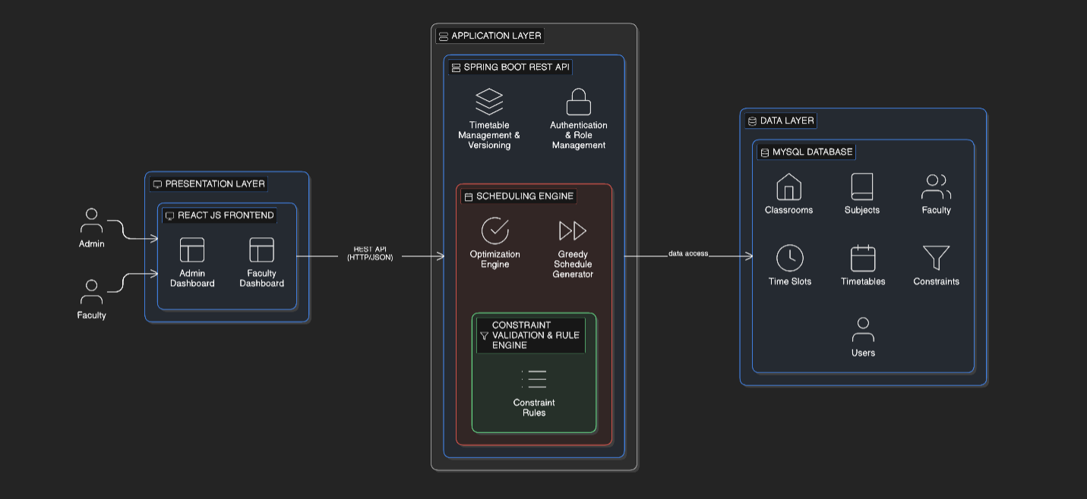
Architecture Diagram

Slide 13
System Modules
1. Admin Module
Manage faculty, subjects, classrooms, and time slots
Configure scheduling rules and constraints
Generate and publish timetables
2. Scheduling Engine Module
Generates conflict-free timetables
Validates faculty availability and room capacity
Optimizes schedules based on defined constraints
3. Classroom Management Module
Maintains classroom details and capacity
Ensures efficient room allocation
Prevents double-booking
4. Faculty Module
View assigned schedules
Check workload and availability
Receive updated timetables
5. Database Module
Stores academic data, rules, and schedules
Maintains consistency and version history

Slide 14
Hardware and Software Details
Hardware Requirements
Processor: Minimum Intel i3 or equivalent
RAM: 4 GB or above
Storage: 20 GB free disk space
System Type: Personal Computer / Laptop
Software Requirements
Frontend: React JS
Backend: Java Spring Boot
Database: MySQL
Web Server: Embedded server
Operating System: Windows / Linux
Development Tools: IDE, Browser

Slide 15
Algorithms
Algorithm
Pairwise Conflict Detection | Core of the scheduling problem — prevents all invalid timetables
Reactive Cascade | Keeps entire UI in sync — the heartbeat of the app
Grid Construction + Slot Lookup | What the user sees — the timetable itself
Slot Placement + Validation | The entry point for all scheduling decisions
Time Slot Sorting | Ensures timetable always displays in logical order

Slide 16
Github Link
The Github link provided should have public access permission.
Github Link
https://github.com/Mshamanth-ui/smart-classroom-timetable-scheduler

Slide 17
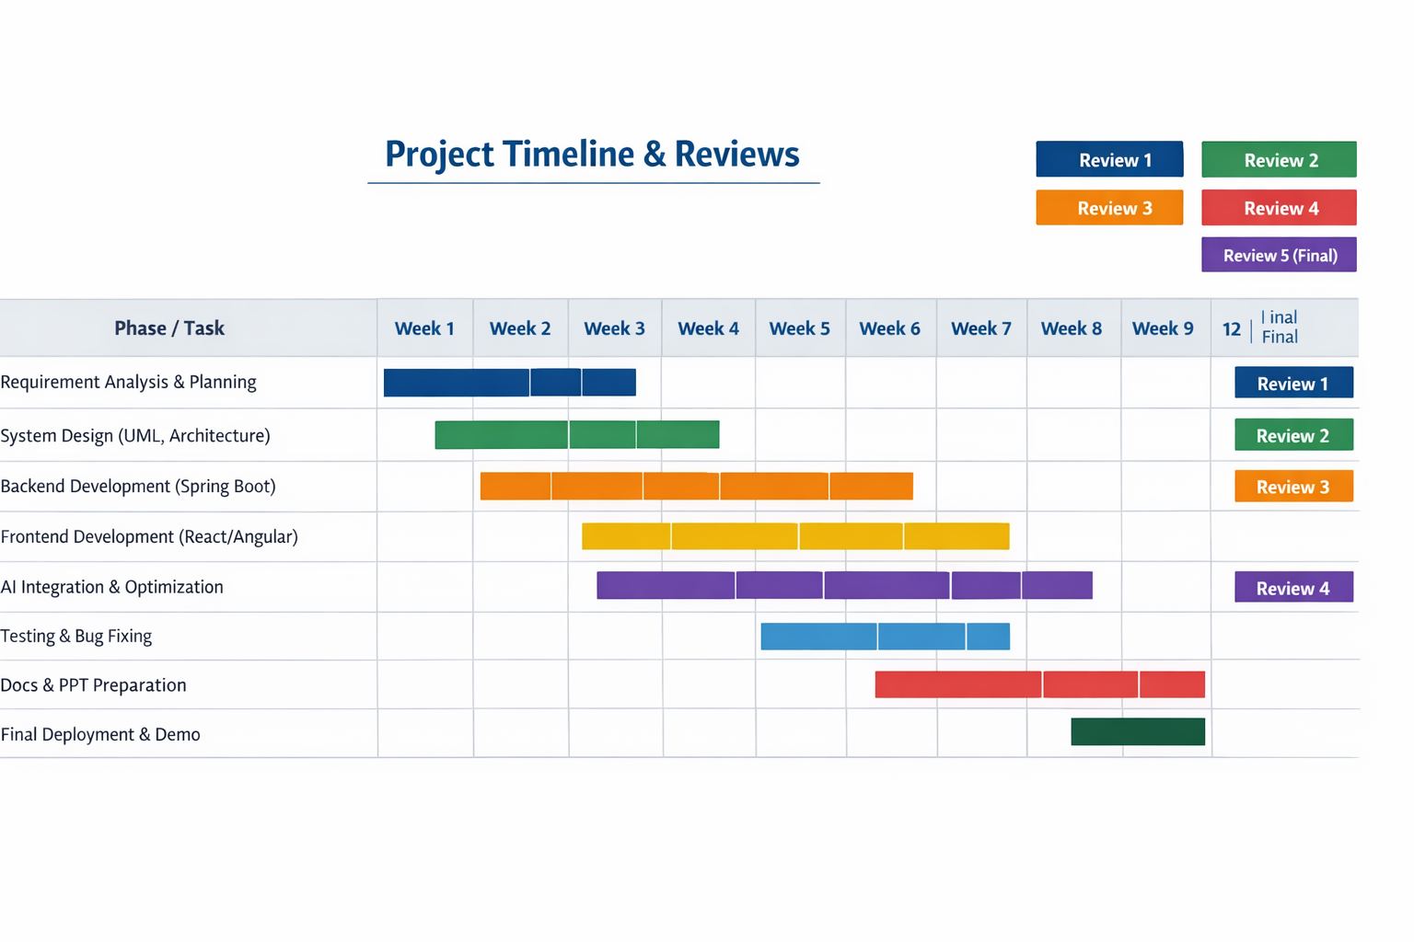
Timeline of the Project (Gantt Chart)

Slide 18
References (IEEE Paper format)
[1] M. E. I. C. Chen, “A Survey of University Course Timetabling Problem: Perspectives, Trends and Opportunities,” IEEE Access, 2021. Available: https://www.researchgate.net/publication/353503798_A_Survey_of_University_Course_Timetabling_Problem_Perspectives_Trends_and_Opportunities
[2] H. Babaei, J. Karimpour, and A. Hadidi, “A survey of approaches for university course timetabling,” Computers & Operations Research, vol. 40, no. 1, pp. 127–151, 2015. Available: https://www.sciencedirect.com/science/article/abs/pii/S0360835214003714
[3] International Timetabling Competition (ITC) 2019 Committee, “International Timetabling Competition 2019: Benchmark Instances and Evaluation,” 2019. Available: https://www.itc2019.org/
[4] M. Müller, “Constraint-Based Timetabling,” Ph.D. dissertation, University Timetabling Project (UniTime), 2005. Available: https://www.unitime.org/papers/phd05.pdf
[5] A. Author, “A Hybrid Genetic Algorithm Approach to a Departmental Class Timetabling Problem,” International Journal of Computer Applications (IJCA), conference proceedings, year. Available: https://ijcaonline.org/volume1/number17/pxc387533.pdf

Slide 19
[6] S. Author, “Automated Timetable Generation using Genetic Algorithm,” International Journal of Advanced Research in Computer and Communication Engineering (IJARCCE), 2015. Available: https://ijarcce.com/wp-content/uploads/2015/03/IJARCCE4I.pdf
[7] X. Author, “Hyper-Heuristics for Course Timetabling Using Tabu Search and Simulated Annealing,” Procedia Computer Science, ScienceDirect, year. Available: https://www.sciencedirect.com/science/article/pii/S1877050919318800
[8] Y. Author, “Reinforcement Learning Approaches to Scheduling and Rescheduling,” arXiv preprint, 2024. Available: https://arxiv.org/pdf/2401.06952
[9] Z. Author, “Modeling and Solving University Course Timetabling Problems,” Journal of Scheduling, Springer, 2023. Available: https://link.springer.com/article/10.1007/s10951-023-00801-w
[10] A. Author, “Occupancy Prediction and IoT-Based Occupancy Detection: A Review,” Sensors, MDPI, vol. 24, no. 11, 2024. Available: https://www.mdpi.com/1424-8220/24/11/3276
[11] B. Author, “Hybrid Technologies and Web-Based Prototypes for Course Timetabling,” SSRN Electronic Journal, 2023–2024. Available: https://papers.ssrn.com/sol3/papers.cfm?abstract_id=4691286

Slide 20


